Slide 1
PERITONEUM & ITS REFLECTIONS
BY
DR OJEWALE A.O.

Slide 2
Outline
Intro’
Layers of peritoneum
Folds
Classification of folds
Peritoneal cavity
Subdivisions
Peritoneum reflections
Supracolic and Infracolic compartments
Applied Anatomy

Slide 3
Intro’
The peritoneum is a large thin serous membrane, which lines the interior of the abdominopelvic cavity. It is made up of a tough layer of elastic tissue lined with the simple squamous epithelium and forms the largest serous sac of the body.
It is similar to the pleura and serous pericardium in consisting of parietal and visceral layers. These layers are separated from each other by a potential space called peritoneal cavity, which is filled with a thin capillary film of fluid.

Slide 4
Cont’d
This fluid lubricates the two layers of the peritoneal cavity and facilitates the movement of those parts of the abdominal viscera, which are enclosed by the visceral layer.
The mobile parts of intra-abdominal digestive tube are completely surrounded by the visceral layer of peritoneum except for a small area where it passes from the tube to the posterior abdominal wall as a double-layered fold called mesentery.

Slide 5
Cont’d
Between the two layers of mesentery is an extraperitoneal fatty areolar tissue in which blood vessels, lymph vessels, and nerves run to and fro from the digestive tubes. Where the two layers of the visceral peritoneum meet the fascial lining of the posterior abdominal wall, they become continuous with the parietal layer of peritoneum. The peritoneal lining is separated from the fascial lining of the abdominal cavity by a layer of loose areolar tissue.

Slide 6
Layers of the peritoneum
The peritoneum forms a closed sac, but when it becomes invaginated by a number of abdominal viscera it is divided into two layers: (a) an outer parietal layer and (b) an inner visceral layer. The folds of peritoneum by which viscera are suspended are called mesentery. Thus, the peritoneum presents two layers: parietal layer called parietal peritoneum and visceral layer called visceral peritoneum.

Slide 7
Cont’d
The parietal peritoneum is a simple layer lining the internal surface of the abdominopelvic walls. The arrangement of the visceral layer is complex. It forms folds, which surround the complex folded and tightly packed gut tube.

Slide 8
Retroperitoneal organs
Classification | Organs
Primarily retroperitoneal | • Kidneys • Suprarenal glands • Ureters
Secondarily retroperitoneal (mesentery lost during development by zygosis) | • Pancreas (except tail) • Duodenum (except initial 2 cm) • Ascending colon • Descending colon • Caecum • Rectum (upper two-third)

Slide 9
PERITONEAL FOLDS
These are formed by the visceral layer of the peritoneum.
Many organs within the abdomen are suspended by the peritoneal folds. These organs are mobile within the abdominal cavity. The degree and direction of their mobility depend on the size and direction of the folds. Apart from allowing mobility to organs, the peritoneal folds also provide pathways for passage to vessels, nerves, and lymphatics.

Slide 10
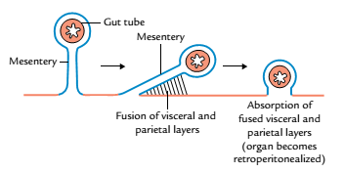
Cont’d
The organs that lie outside the peritoneal cavity (retroperitoneal organs) are fixed and immobile.
Some organs are initially suspended by the peritoneal folds, i.e., they possess mesenteries but later on lose their mesenteries by a process called zygosis and become retroperitoneal.
Process of Zygosis

Slide 11
CLASSIFICATION OF THE PERITONEAL FOLDS
The peritoneal folds are classified into three types: mesentery/mesocolon, omenta, and ligaments.
Mesentery/mesocolon: The peritoneal fold suspending the small intestine is called mesentery and the peritoneal fold suspending the colon is called mesocolon.
Omenta (singular omentum):These are the peritoneal folds that connect the stomach with other viscera.

Slide 12
Cont’d
The examples of the omenta are:
Greater omentum, a fold connecting the stomach with the transverse colon.
Lesser omentum, a fold connecting the stomach with the liver.
Gastrosplenic omentum, a fold connecting the stomach with the spleen (it is usually termed gastrosplenic ligament).

Slide 13
Cont’d
Ligaments: They are the folds that connect organs to the abdominal wall or to each other. The examples are gastrosplenic ligament (between stomach and spleen), lienorenal ligamentum (between kidney and spleen), and coronary ligaments (between liver and diaphragm).

Slide 14
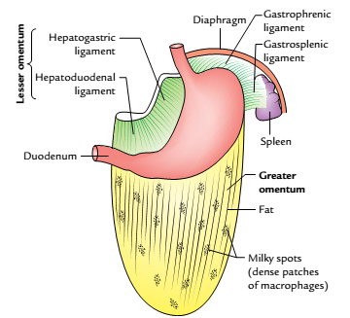
Greater Omentum
The greater omentum is a large, thick, apron-like fold of peritoneum, that hangs down from the greater curvature of stomach and the first part of the duodenum and covers the loops of intestine to a variable extent.
Greater omentum

Slide 15
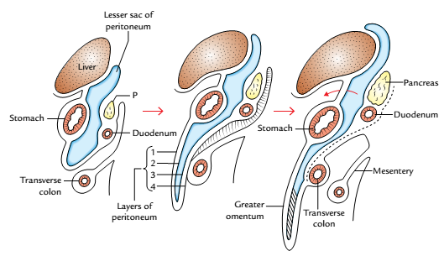
Cont’d
The greater omentum is made up of four layers of peritoneum, which are fused together to form a thin fenestrated membrane containing variable amount of fat.
Stages of development of greater omentum (P = pancreas)

Slide 16
Attachments of the greater omentum
The anterior two layers descend from the greater curvature of the stomach (where they are continuous with the peritoneum covering the anterior and posterior surfaces of the stomach) to a variable extent and then folds on itself to form the posterior two layers.
The mode of folding is such that the first layer becomes the fourth layer and the second layer becomes the third layer.

Slide 17
Cont’d
The posterior two layers ascend up to the transverse mesocolon where the fourth layer loosely blends with the peritoneum on the anterior surfaces of the transverse colon and transverse mesocolon above it. The part of lesser sac between the second and third layers gets obliterated except for about 1 inch (2.5 cm) below the greater curvature of the stomach.

Slide 18
Contents of the greater omentum
Adipose tissue (fat) of variable amount depending upon the nutritional status of an individual.
Aggregation of macrophages, which form dense patches called milky spots.
Right and left gastroepiploic vessels run between the anterior and posterior layers of the greater omentum close to the greater curvature of the stomach.

Slide 19
The functions of greater omentum
Fat storage: It is a storehouse of adipose tissue.
Immune defense: It protects the peritoneal cavity from infection due to the presence of a large number of macrophages.
Infection control: It limits the spread of infection. The greater omentum moves to the site of infection and seals it off from the surrounding areas. It also moves to the site of perforation of gut to plug the gap to prevent the leakage of contents of gut in the peritoneal cavity.

Slide 20
Cont’d
Grafting: It is used sometimes as grafting material (biological patch and reinforcement) by the surgeons.
Protection: It protects the abdominal viscera from blow on the anterior abdominal wall.
It forms a partition between the supracolic and the infracolic compartments of the greater sac.

Slide 21
Lesser Omentum
The lesser omentum is a double-layered fold of peritoneum between the lesser curvature of stomach and the inferior surface of the liver.
Parts
The part of lesser omentum between stomach and liver is called hepatogastric ligament, and the part between duodenum and liver is called hepatoduodenal ligament.

Slide 22
Attachments
Superiorly, it is attached in the inverted ‘L’-shaped manner to the margins of fissure for ligamentum venosum and porta hepatis.
Inferiorly, it is attached to the right side of the abdominal esophagus, lesser curvature of the stomach, and first 2 cm of the duodenum.

Slide 23
Contents
Along the lesser curvature of the stomach, the lesser omentum contains:
Right and left gastric vessels and associated gastric lymph nodes.
Branches of the left gastric nerve.
The right free margin of the lesser omentum contains:
Portal vein
Hepatic artery and bile duct anterior to the portal vein, with duct to the right of the artery.
Autonomic nerves.
Lymphatic and lymph nodes

Slide 24
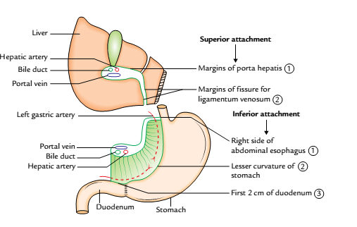
Attachments and contents of the lesser omentum

Slide 25
Mesentery (Mesentery of Small Intestine)

Slide 26
Mesentery (Mesentery of Small Intestine)
It is a broad fan-shaped fold of the peritoneum, which suspends the coils of the small intestine (jejunum and ileum) from the posterior abdominal wall.
The width of mesentery on an average is about 6 inches (15 cm). The maximum width is 8 inches (20 cm) in the central part and gradually diminishes toward the proximal and distal ends.

Slide 27
General Features
The mesentery presents two borders:
Attached border (or root).
Free border (or intestinal border).
Root of mesentery (attached border): It is attached to an oblique line across the posterior abdominal wall, extending from the duodenojejunal flexure to the ileocecal junction.
The duodenojejunal flexure lies to the left side of L2 vertebra, whereas the ileocaecal junction lies at the upper part of the right sacroiliac joint.

Slide 28
Cont’d
The root of mesentery from above downward crosses in front of:
Horizontal (third) part of duodenum.
Abdominal aorta.
Inferior vena cava.
Right gonadal vessels.
Right ureter.
Right psoas major muscle.

Slide 29
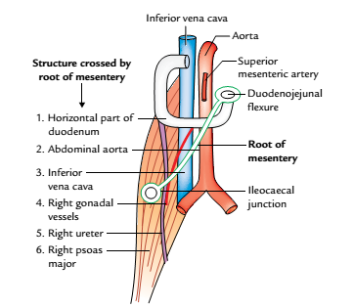
Structures crossed by the root of the mesentery

Slide 30
Cont’d
The root of mesentery divides the infracolic compartment into two parts: right and left.
The right one is smaller and terminates in the right iliac fossa.
The left one is larger and passes without interruption into true pelvis.

Slide 31
Cont’d
Free border (intestinal border): It is about 6 m (20 feet) long and encloses the jejunum and ileum. The root of mesentery is 6 inches (15 cm) long whereas its periphery (free border) is 6 m long. This accounts for the formation of folds (pleats) in it.
Its length permits the free mobility of the loops of jejunum and ileum in the abdominal cavity.

Slide 32
Cont’d
It has fat deposition along its root, which diminishes toward the intestinal border. Near the intestinal border, it presents fat-free oval/circular windows (translucent area) of peritoneum. The amount of fat is greater in the distal part of the mesentery.

Slide 33
Contents
The contents of the mesentery are:
Superior mesenteric artery and vein (in the root)-with vein being to the right of the artery.
Jejunal and ileal branches of superior mesenteric artery and accompanying veins.
Lymphatics.
Lymph nodes (100-200 in number).
Autonomic nerve plexuses.
Fat and connective tissues.
Jejunum and ileum (enclosed in the free border)

Slide 34
Transverse mesocolon

Slide 35
Transverse mesocolon
It is a broad horizontal fold of peritoneum, which suspends the transverse colon from the posterior abdominal wall.
The line of attachment of the root of transverse mesocolon on the posterior abdominal wall (or rather to the organs that lie on the posterior abdominal wall at that level) is horizontal with an upward inclination toward the left. From right to left, it is attached to the anterior aspect of the head and anterior border of the body of pancreas

Slide 36
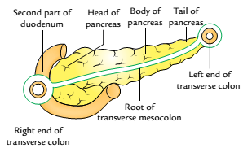
Attachments of the root of transverse mesocolon

Slide 37
Sigmoid mesocolon

Slide 38
Sigmoid mesocolon
The sigmoid mesocolon is a triangular fold of peritoneum, which suspends the sigmoid colon from the pelvic wall. The attachment of the root of sigmoid mesocolon on to the pelvic wall takes the form of an inverted ‘V’, the apex of which lies at the division of the left common iliac artery.
The intersigmoid recess of peritoneum is found at the apex of the V-shaped attachment and the left ureter lies behind the peritoneum of the intersigmoid recess

Slide 39
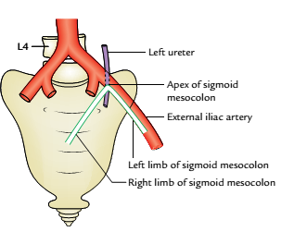
Cont’d
The left limb of V-shaped is attached along the upper half of the left external iliac artery and the right limb to the posterior pelvic wall extending downward and medially from the apex to the median plane of sacrum up to the level of S3 vertebra.
Attachments of the root of sigmoid mesocolon

Slide 40
Falciform Ligament

Slide 41
Falciform Ligament
It is a sickle-shaped fold of peritoneum, which connects the anterosuperior surface of the liver to the supraumbilical part of the anterior abdominal wall and the inferior surface of the diaphragm.
Its concave inferior margin contains the ligamentum teres (the obliterated left umbilical vein). The ligamentum teres extends from the umbilicus to the notch for this ligament on the inferior border of the liver and joins the left branch of the portal vein at the left end of the porta hepatis.

Slide 42
The contents of falciform ligament
Ligamentum teres.
Paraumbilical veins, tributaries of portal vein.
Numerous small veins which connect paraumbilical vein with the diaphragmatic veins.

Slide 43
PERITONEAL CAVITY

Slide 44
Peritoneal cavity
The peritoneal cavity is the largest and most complex serous sac in the body.
It is a potential space between the parietal and visceral layers of the peritoneum.
In the male, the peritoneum is a closed serous sac lined with mesothelium & In the female, the peritoneum is not a closed sac because it communicates with the exterior through uterine tubes, uterus, and vagina.

Slide 45
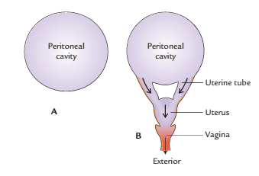
Cont’d
It is also lined by mesothelium as in male. therefore, pelvic infections are common in the females.
Peritoneal cavity: A, in the male;B, in the female

Slide 46
Differences between parietal and visceral peritoneum
Parietal peritoneum | Visceral peritoneum
Arrangement of the parietal layer of the peritoneum is simple. | Arrangement of the visceral layer of peritoneum is complex.
It lines the inner surface of the abdominopelvic walls (parietes) from which it is separated by extraperitoneal connective tissue and therefore can be easily stripped off | It forms mesenteries, which surround the intricately folded and tightly packed gut tube, liver, and spleen. It is firmly attached to the outer surface of the viscera and cannot be stripped off.
It is derived from the somatopleuric layer of the lateral plate mesoderm. | It is derived from the splanchnopleuric layer of the lateral plate mesoderm.
It is innervated by somatic nerves and therefore is sensitive to pain | It is innervated by the autonomic nerves and therefore is insensitive to pain

Slide 47
Subdivisions of the peritoneal cavity

Slide 48
Subdivisions of the peritoneal cavity
It may be broadly divided into two parts:
Greater sac.
Lesser sac (or omental bursa).
The greater sac is the larger (main) compartment of the peritoneal cavity and extends across the whole breadth and length of the abdomen.

Slide 49
Cont’d
The lesser sac is the smaller compartment of the peritoneal cavity, which lies behind the stomach, liver, and lesser omentum as a diverticulum from the greater sac.
The two sacs communicate with each other through the foramen epiploicum.

Slide 50
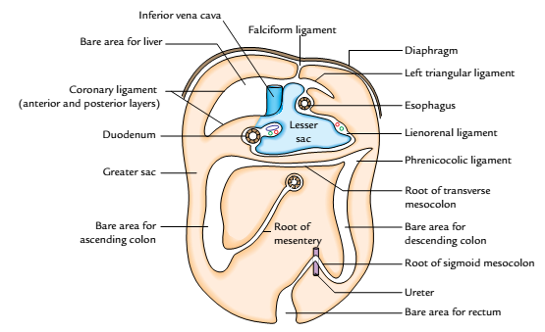
The division of peritoneal cavity into greater sac (orange colour) and lesser sac (light blue colour).

Slide 51
Peritoneum reflection
The peritoneum is a large serous membrane, which lines the interior of the abdomino-pelvic walls, roof, and floor. It is reflected along certain lines from these parietes to be continuous with a layer of peritoneum over certain viscera.
Thus, although the peritoneum is usually divided descriptively into parietal and visceral layers, they are really parts of the same membrane.

Slide 52
Greater sac
It is the main part of the peritoneal cavity and into this sac protrudes all the peritoneal organs.

Slide 53
Supracolic and Infracolic compartments of the peritoneal cavity
The abdominal part of the peritoneal cavity is divided into anterosuperior supracolic and posteroinferior infracolic compartments by transverse colon and its mesentery-the transverse mesocolon.

Slide 54
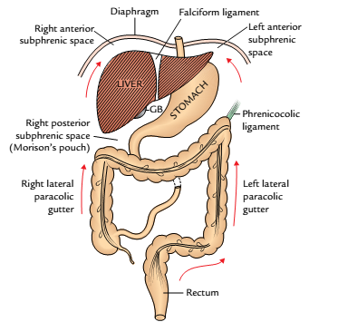
Showing subphrenic spaces and paracolic gutters (GB = gallbladder)

Slide 55
Supracolic Compartment
The supracolic compartment is largely under the cover of costal margin and diaphragm.
It surrounds the liver, stomach, spleen, and the superior part of the duodenum. It lies anterior to the pancreas, duodenum, kidney, and suprarenal glands. The attachments of the liver to the diaphragm and anterior abdominal wall define the subdivisions of the supracolic compartment.

Slide 56
Infracolic Compartment
It is filled with the coils of jejunum and ileum, and surrounded by ascending, transverse, and descending colons.
The infracolic compartment below the level of transverse mesocolon is divided into right and left infracolic spaces by the root of the mesentery of the small intestine.

Slide 57
The right infracolic space is triangular with its apex lying below at the ileocaecal junction. It is bounded on the right side by the ascending colon, above by the transverse mesocolon, and on the left side by the mesentery of the small intestine.
The left infracolic space is larger than the right infracolic space and is quadrangular in shape. It is bounded above by the transverse mesocolon on the right by the root of mesentery, and on the left by the descending colon. Below it is continuous across the pelvic brim into the pelvic cavity.

Slide 58
intraperitoneal fossae
The peritoneal cavity presents a number of small pockets/recesses called fossae into which loops of bowel may become caught and get strangulated. The important ones are:
Lesser sac: A diverticulum of the peritoneal cavity behind the stomach.
Paraduodenal fossa: A peritoneal recess between the duodenojejunal flexure and the inferior mesenteric vein. Its orifice looks to the right.

Slide 59
Cont’d
Retrocaecal fossa: A recess of the peritoneum behind caecum, in which the appendix frequently lies.
Intersigmoid fossa: A triangular recess formed by the inverted V-shaped attachment of the sigmoid mesocolon. This recess is open inferomedially.

Slide 60
Subphrenic spaces
Six spaces are well defined in relation to the periphery of the liver below the diaphragm called subphrenic spaces. These spaces are of great importance to surgeons because pus often collects in these spaces forming subphrenic abscesses. The ligaments of the liver play a major role in delimiting these spaces. Of these six spaces, three are on the right side and three on the left side. Out of the three spaces on each side, two are intraperitoneal and one is extraperitoneal.

Slide 61
Cont’d
They are named as follows:
Right posterior intraperitoneal compartment.
Right anterior intraperitoneal compartment.
Right extraperitoneal compartment.
Left posterior intraperitoneal compartment.
Left anterior intraperitoneal compartment.
Left extraperitoneal compartment.

Slide 62
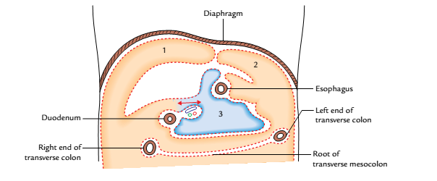
Anatomy of the subphrenic spaces, the viscera having been removed: 1 = right anterior intraperitoneal compartment, 2 = left anterior intraperitoneal compartment, 3 = left posterior intraperitoneal compartment.

Slide 63
RIGHT POSTERIOR INTRAPERITONEAL COMPARTMENT (hepatorenal pouch or Morison’s pouch)
It is situated between the posteroinferior surface of the liver and front of the right kidney.
Boundaries
Anterior: Posteroinferior (visceral) surface of the liver.
Posterior: Peritoneum covering the front of the upper pole of the right kidney and the diaphragm.
Above: Posterior (inferior) layer of the coronary ligament.
Below: Transverse colon and mesocolon

Slide 64
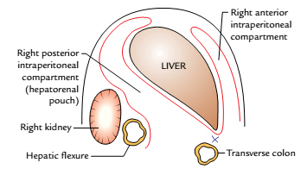
Cont’d
Communications
On the left: It communicates through foramen epiploicum with the lesser sac of peritoneum (omental bursa).
Along the sharp inferior border of liver: It communicates with the right anterior intraperitoneal compartment.

Slide 65
Right anterior intraperitoneal compartment
It is situated between the anterior surface of the right lobe of the liver and diaphragm in front of the superior layer of coronary ligament and right triangular ligament.

Slide 66
Boundaries
Anterior: Diaphragm and anterior abdominal wall.
Posterior: Anterior surface of the liver.
Superior: Superior layer of the coronary ligament.
Left: Right side of the falciform ligament.
Right: Fossa communicates with the right posterior intraperitoneal compartment.
Below: Open

Slide 67
Right extraperitoneal compartment
It is the space between the bare area of the liver and the diaphragm.
The right extraperitoneal compartment is completely shut off and if it is distended by fluid or pus, the liver may be pushed down and the diaphragm may be pushed up.

Slide 68
Boundaries
Anterior: Superior layer of the coronary ligament.
Posterior: Inferior layer of the coronary ligament.
Left: Inferior vena cava.
Right: Fusion of the two layers of coronary ligament to form the right triangular ligament.
Above: Diaphragm.
Below: Posterior surface of the liver.

Slide 69
Left posterior intraperitoneal compartment
(Lesser sac)
The lesser sac (also called omental bursa) is a diverticulum of the peritoneal cavity behind the stomach. It communicates with the greater sac through a slit-like aperture called epiploic foramen (or foramen of Winslow).

Slide 70
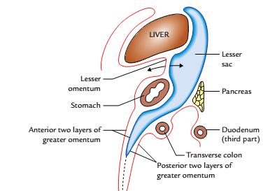
Lesser sac: as seen in the sagittal section.

Slide 71
Boundaries
Anterior wall: From above downward, it is formed by: caudate lobe of the liver, lesser omentum, posteroinferior surface of the stomach, anterior two layers of the greater omentum.
Posterior wall: From below upward, it is formed by: posterior two layers of the greater omentum, and structures forming the stomach bed except spleen are:
Transverse colon, Transverse mesocolon.
Pancreas, Upper part of the left kidney and left suprarenal gland & Diaphragm.

Slide 72
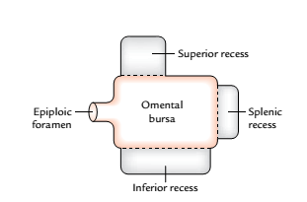
Recesses of Lesser Sac
The lesser sac (omental bursa) presents the following three recesses
Superior recess: It lies behind the lesser omentum and the liver. The portion behind the lesser omentum is termed vestibule of the lesser sac.
Inferior recess: It lies between the anterior two layers and the posterior two layers of the greater omentum.
Splenic recess: It lies between the gastrosplenic and lienorenal ligaments.
The recesses of lesser
sac (omental bursa)

Slide 73
Foramen Epiploicum (Foramen of Winslow)
The foramen epiploicum is a vertical slit through which lesser sac of peritoneum (omental bursa) communicates with the greater sac of peritoneum. It is situated behind the right free margin of lesser omentum at the level of T12 vertebra

Slide 74
Boundaries of the Foramen Epiploicum
Anterior: Right free border of the lesser omentum containing bile duct, vertical part of the hepatic artery, and portal vein.
Posterior: Inferior vena cava and right suprarenal gland.
Superior: Caudate process of the caudate lobe of the liver.
Inferior: First part of the duodenum and horizontal part of the hepatic artery.

Slide 75
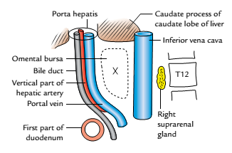
Boundaries of the foramen epiploicum (foramen of winslow)

Slide 76
Left anterior intraperitoneal compartment
It lies between the left lobe of the liver and the diaphragm in front of the left triangular ligament.
Boundaries
Anterior: Abdominal wall.
Posterior: Liver.
Above: Left triangular ligament.
Right: Falciform ligament.
Left: Open.
Below: Open

Slide 77
Cont’d
Communications
Below, it is continuous in front of the lesser omentum and stomach.
To the left, it is continuous around the spleen.

Slide 78
Left extraperitoneal compartment
It is merely the loose connective tissue around the upper pole of the left kidney and left suprarenal gland.
It is hardly infected and therefore is the least important of the six subphrenic spaces.

Slide 79
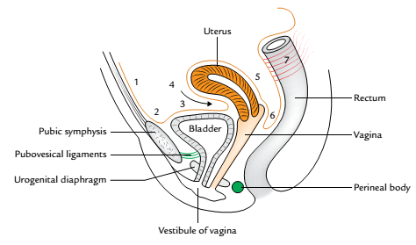
Cont’d
The rectouterine pouch is bounded:
Anteriorly: By the uterus and the upper one-third of the vagina (posterior fornix of vagina).
Posteriorly: By the rectum.
Inferiorly (floor): By the rectovaginal fold of the peritoneum.
The floor of the pouch is about 5.5 cm above the perineal skin.
Peritoneum of the female pelvis (sagittal section): 1:anterior abdominal wall; 2: back of the pubis; 3: superior surface of the bladder; 4:uterovesical pouch; 5:posterior surface of the uterus and posterior fornix; 6:rectouterine pouch (of Douglas); 7:rectum.

Slide 80
Applied Anatomy
The great length of the mesentery permits the descent and protrusion of the loops of the small intestine into the hernial sacs of inguinal and femoral hernias.
The failure of the root of mesentery to fuse over its entire length with the posterior abdominal wall allows a peritoneal pocket to be formed which may form a sac of an intraperitoneal hernia called mesenteric parietal hernia of Waldeyer.

Slide 81
Cont’d
Peritoneal dialysis: The peritoneum is a semipermeable membrane with an extensive surface area much of which overlies blood and lymphatic capillary beds. It is a procedure by which waste products such as urea are removed from the blood in patients with renal failure.
Paracentesis abdominis: It is a procedure by which excessive collection of intraperitoneal fluid is evacuated by canula inserted through the abdominal wall.

Slide 82
Cont’d
The canula inserted in the flank will pass through the skin, superficial fascia, aponeurosis of external oblique muscle, internal oblique muscle, transversus abdominis muscle, fascia transversalis, extraperitoneal fat, and parietal peritoneum.
The peritoneal cavity is capable of great distension following the collection of fluid (ascitis), blood (hemoperitoneum), and air (pneumoperitoneum).

Slide 83
Cont’d
Hepatorenal pouch: It is important to note that the right posterior intraperitoneal and right anterior intraperitoneal compartments communicate with each other along the sharp anterior border of the liver. But if abscess forms in one of these compartments, the pus is prevented from extending around the sharp inferior border of the liver to enter other compartment due to the formation of adhesions between transverse colon and greater omentum and inferior border of the liver.

Slide 84
Cont’d
Pseudocyst of pancreas: The collection of fluid in the lesser sac occurs most frequently, as a result of acute pancreatitis or sometimes after pancreatic injury forming “pseudocyst of pancreas.” The pseudocyst of pancreas projects forward either between the stomach and liver or between the stomach and transverse colon. The perforation of posterior wall of stomach also results in the passage of its fluid contents in the lesser sac.

Slide 85
Cont’d
Control of hemorrhage during cholecystectomy: If the cystic artery is torn during cholecystectomy, the surgeon can stop hemorrhage by compressing the hepatic pedicle (formed by the right free margin of lesser omentum), containing portal vein, hepatic artery and bile duct, between the index finger and thumb. It is achieved by inserting the index finger in the foramen of Winslow and compressing the hepatic pedicle against it by the thumb.

Slide 86
Cont’d
Internal hernia: Sometime, the loop of the small intestine may herniate into the lesser sac through foramen epiploicum, producing an internal hernia. This hernia if strangulated cannot be reduced by cutting any of the important boundaries of the foramen of Winslow. However, it can be reduced by aspirating the gut contents and pushing the herniated loop out from the lesser sac by inserting the index finger into it through the anterior two layers of greater omentum or through the transverse mesocolon.

Slide 87
Cont’d
Rectouterine pouch: It is the most dependent part of the peritoneal cavity below the pelvic brim the pus tends to collect here and form the pelvic abscess. The pus can be drained either through the rectum or through the posterior fornix of the vagina (posterior colpotomy).

Slide 88


